Slide 1





MINOR PROJECT
Applications of Red Fox Algorithm in Unit Commitment Problem
Guided By: Dr. Kuntal Bhattacharjee
Presented by: Priyanshu (20BEE094) & Vinamra (20BEE129)
_{Date: 21th October 2023}

Slide 2


What is the Unit Commitment Problem?
The Unit Commitment Problem (UCP) is a well-known optimization problem in power systems. It aims to determine the optimal dispatch strategy for power generators to satisfy the electrical demand while meeting various operational constraints.

Slide 3

The Challenges Associated with Unit Commitment
Uncertainty
Cost
Constraints
Load and renewable energy
sources have high levels of
uncertainty, making it
difficult to plan and commit
generators accurately.
The cost of operating
generating units and gas constraints are essential
factors in unit commitment
optimization. Failing to
consider the cost
implications may lead to an uneconomic schedule.
The unit commitment
process must adhere to
various constraints such as Spinning Reverse, Min UP/DOWN time limits, and ramp rate constraints.
Compliance with these limits
plays a significant role in
power system operation.

Slide 4


Project Goals
1.
Our project aims to leverage the Red Fox Algorithm's ability to optimize Unit Commitment (UCP) problems more quickly and efficiently compared to traditional methods.
2.
Our goal is to leverage the Red Fox Algorithm's unique behavioral model to find more accurate and optimal solutions for Unit Commitment problems, while meeting energy production constraints.

Slide 5
Red Fox Algorithm
This is a nature- inspired optimization algorithm which mimics the foraging behaviour of red foxes in snow when hunting preys.
The algorithm is designed by Mohammed, H., Rashid, T. in 2022.
The algorithm is based on techniques for measuring the distance between the fox and its prey to execute an efficient jump.

Slide 6
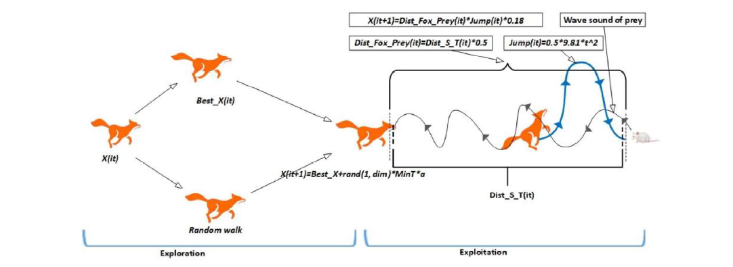
Red Fox Behaviour
Red foxes adapt to snowy conditions by searching for prey randomly when the ground is covered with snow, as it obstructs their visibility.
They locate prey by listening to ultrasound signals emitted by the prey, and use the time difference between hearing these signals to estimate the distance to the prey.
Based on the estimated distance, red foxes calculate the required jump height to catch the prey, and they navigate by walking randomly, considering the minimum time and the best position.

Slide 7



Process
1.
2.
Problem Formulation
Algorithm Implementation
Formulate the unit commitment optimization problem to use the Red Fox Algorithm.
Implement the algorithm and run the code.
How to solve unit commitment problem using Red Fox algorithm
3.
Optimization Results
Analyze the results to evaluate the effectiveness of the Red Fox Algorithm against other optimization techniques.

Slide 8
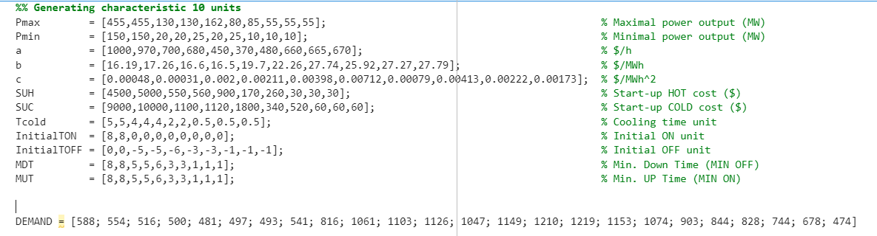
1. Problem Formulation
Define objective function as cost function
Define function to check constraints
Sample Input

Slide 9
2. Red Fox Implementation
FOX initializes the population, which is called the X matrix. An X is the position of red foxes.
To investigate the BestFitness and best position (BestX), the fitness value of each search agent (each row in an X matrix) is compared to the fitness of other agents (other rows).
BestFitness and BestX are conducted using a condition that is used to compare the fitness of the new row (fitness (i+1)) and fitness of the previous row (fitness( i) ) throughout iterations are returned.
Using a random variable called r, we assign nearly half of the iterations are used for exploration and the other half for exploitation to avoid local optima.

Slide 10


Flowchart
Start
Initialize Population
Calculate fitness of search agents
No
If r >= 0.5
Yes
No
If p > 0.18
Yes
Search for new X using Eq. 9
Find new X using Eq.6
Find new X using Eq. 5
Change X if they are beyond the limitation
Calculate fitness and return the best fitness
End

Slide 11
Exploitation
Random Walking: The red fox employs a random variable 'a' and minimum time variable to control its search towards the best position.
Stochastic Exploration; By using a random number 'r' and the minimum time average, the fox walks stochastically, exploring the search space.
Finding New Positions: Equation (9) guides the exploration technique, allowing the fox to find new positions while balancing exploration and exploitation.

Slide 12
Exploration
Chance of Catching Prey: A random variable 'p' determines the chance of the red fox successfully catching the prey. If p > 0.18, a new position is sought.
Calculating Distance Sound Travels: The distance sound travels is determined by speed of sound and the sound travel time, which is a random variable within the algorithm.
Best Position Calculation: The speed of sound is derived from the best position found so far. It helps calculate the distance of the fox from the prey.
Finding Jump Height: The fox calculates the jump height based on the distance between the fox and the prey. It is used in the subsequent exploration phase.

Slide 13

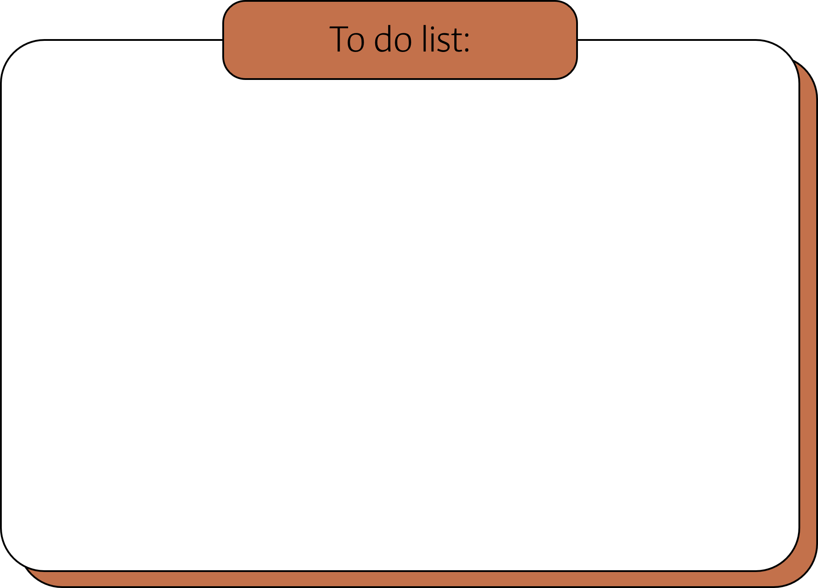
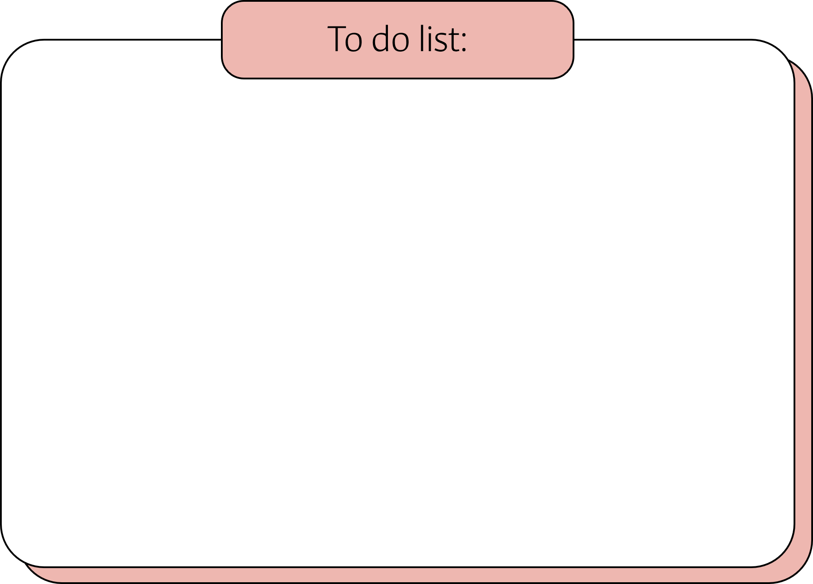
Exploitation
Exploitation
𝐷𝑖𝑠𝑡_𝑆_𝑇𝑖𝑡 = 𝑆𝑝_𝑆 ∗ 𝑇𝑖𝑚𝑒_𝑆_𝑇𝑖𝑡, (1)
𝑆𝑝_𝑆 = 𝐵𝑒𝑠𝑡𝑃𝑜𝑠𝑖𝑡𝑖𝑜𝑛𝑖𝑡 / 𝑇𝑖𝑚𝑒_𝑆_𝑇𝑖𝑡 (2)
𝐷𝑖𝑠𝑡_𝐹𝑜𝑥_𝑃𝑟𝑒𝑦𝑖𝑡 = 𝐷𝑖𝑠𝑡_𝑆_𝑇𝑖𝑡 ∗ 0.5 (3)
𝐽𝑢𝑚𝑝𝑖𝑡 = 0.5 ∗ 9.81 ∗ 𝑡2 (4)
𝑋(𝑖𝑡+1)= 𝐷𝑖𝑠𝑡_𝐹𝑜𝑥_𝑃𝑟𝑒𝑦𝑖𝑡* 𝐽𝑢𝑚𝑝𝑖𝑡 * 𝑐1 (5)
𝑋(𝑖𝑡+1) = 𝐷𝑖𝑠𝑡_𝐹𝑜𝑥_𝑃𝑟𝑒𝑦𝑖𝑡 ∗ 𝐽𝑢𝑚𝑝𝑖𝑡 ∗ 𝑐2 (6)
𝑡𝑡 = 𝑠𝑢𝑚 (𝑇𝑖𝑚𝑒𝑆𝑇 𝑖𝑡 (𝑖, : )) / 𝑑𝑖𝑚𝑒𝑛𝑠𝑖𝑜𝑛, 𝑀𝑖𝑛𝑇 = 𝑀𝑖𝑛(𝑡𝑡) (7)
a = 2 ∗ (𝑖𝑡 − (1 / 𝑀𝑎𝑥𝑖𝑡)) (8)
𝑋(𝑖𝑡+1) = 𝐵𝑒𝑠𝑡𝑋𝑖𝑡 ∗ 𝑟𝑎𝑛𝑑(1, 𝑑𝑖𝑚𝑒𝑛𝑠𝑖𝑜𝑛) ∗ 𝑀𝑖𝑛𝑇 ∗ 𝑎 (9)

Slide 14
Future Work
We are evaluating the existing solutions within the PSO Algorithm to ensure a successful implementation of unit commitment using the Red Fox approach.
We will compare the outcome of Red Fox with PSO solution in order to get insight of accuracy and efficiency of Red Fox Algorithm.

Slide 15





Thank You

